Slide 1

COM7411 Research Methods
Research Philosophy and Paradigms
Week 1 – Session 2

Slide 2

By the end of the session, you should be able to…
Define ontology and contrast realist and constructivist views
Apply ontological positions to CS, DA and CY research problems
Argue a position in a debate and test it against a rival
State your own provisional ontological position

Slide 3

What’s it all about
Through debate, analysis and discussion you will examine ontology – what we assume exists – and apply competing positions to CS, DA and CY research problems. You will then reflect on your own philosophical position and why it must align with your research questions and methods.
Notes:
A researcher’s philosophical choices shape the assumptions, perceptions and interpretations of the nature of reality. Our individual research philosophy in relation to a particular research project influences how we see the research problem, how we understand data, what analysis we make, what conclusions we draw and what theories we advance. For example, in some studies, we may take a human-centric approach, in other studies, we may take a techno-centric approach and on occasion we may balance the two in a techno-human approach. Consequently, a researcher must be grounded in understanding the need to adopt a clearly stated research philosophy, early in the research process.

Slide 4
Check-in: your pre-reading
Which cheat sheet did you find hardest?
Ontology
Epistemology
Axiology
Doxology
Epistemology, axiology and doxology are pre-reading – use today’s questions to clear up anything unclear.

Slide 5

All the resources will be posted to the Moodle page
Familiarise yourself with the Moodle page and its contents

Slide 6

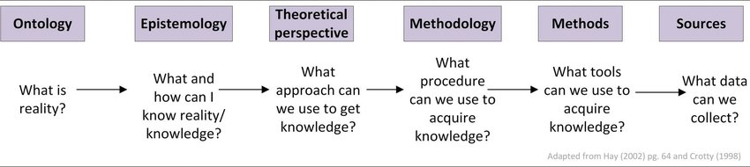
Things you may come across this week
Philosophical perspectives are important because, when made explicit, they reveal the assumptions that you are making about your research.
They lead to choices that are applied to the purpose, design, methodology and methods of the research, as well as to data analysis and interpretation

Slide 7

Ontology

Slide 8
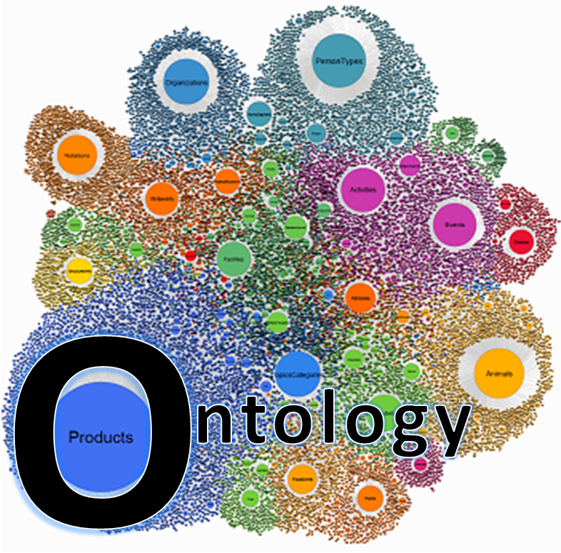

Ontology
What entities exist in the world?
Going to give you 30 seconds
How do they relate
to one another?
Going to give you 30 seconds
Is reality independent of our perception (realism) or constructed through simple experience of the reception and demultiplexing of electrical signals interpreted, in the dark by your brain (constructivism)?
Going to give you…
Ontology is the study of ‘being’ –
the study of reality.
10 seconds?
Notes:
Why Ontology Matters in Research:
Shapes how researchers understand the objects and phenomena they study. Influences the research design, the way data is collected, and the interpretation
By defining the nature and relationships of entities within a domain, ontology plays a crucial role in developing frameworks that support data structures, algorithms, and system designs.
of findings.

Slide 9

Ontology
Ontology is a branch of philosophy that deals with the ‘study of being’ - REALITY. It focuses in what exists and how entities are grouped together.
Ontology helps recognize how certain you can be about the reality of objects you are researching. E.g., How do you deal with different and conflicting ideas of reality?
A realist ontology relates to the existence of one single reality which can be studied, understood and experienced as a ‘truth’; a real world exists independent of human experience.
A Constructivist ontology is based on the philosophy that reality is constructed within the human mind, such that no one ‘true’ reality exists.
Notes:
Ontology forms the foundation of how we understand and structure the reality of the research problem in CS, IS, and CY. By defining the nature and relationships of entities within a domain, ontology plays a crucial role in developing frameworks that support data structures, algorithms, and system designs.

Slide 10


Ontological Assumptions in CS:
Realist Ontology is prevalent in CS research. It assumes that systems, algorithms, and data structures exist independently of the observer.
Computer systems, algorithms, and databases are treated as objective entities with measurable properties.
Applications of Ontology in CS:
  Algorithm Design: Algorithms are seen as formal objects that can be optimized and studied independently of user context.
  Software Engineering: Systems are developed based on the assumption that they behave predictably, based on coded rules and logic.
  Artificial Intelligence (AI): AI systems often operate on the assumption that intelligence and decision-making processes can be formalized as independent entities (e.g., neural networks).

Slide 11
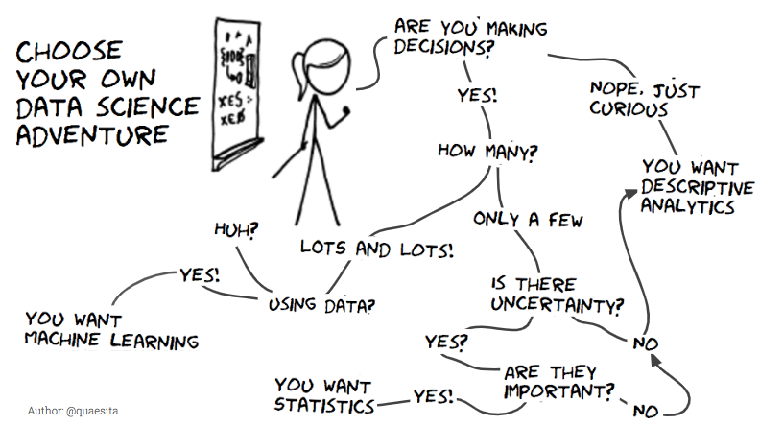
Ontology in Data Analytics
Realism: Data exists as objective, measurable information that reflects real-world phenomena.
Constructivism: Data is shaped by the way it is collected, interpreted, and analysed, meaning that reality can be constructed through analysis and contextual understanding.
Applications of Ontology in Data Analytics:
  Big Data Analytics: Treats data as an independent, objective reality that can be mined to discover patterns, trends, and correlations.
  Predictive Modelling: Assumes that future behaviours or events can be accurately predicted based on historical data, treating data as representative of real-world behaviour.
  Human-Centered Data Analysis: Recognizes that data may not be entirely objective and is influenced by human collection methods, biases, and contextual interpretation (e.g., social media analysis).

Slide 12
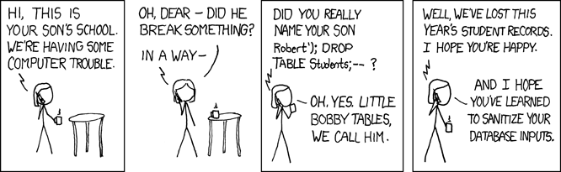
Ontological Assumptions in Cybersecurity
Realist Approach: Systems and threats (e.g., malware, network vulnerabilities) are seen as existing independently and can be objectively analysed and mitigated.
Constructivist Approach: Security risks are also influenced by human factors, such as user behaviour, organizational culture, and perceptions of risk, which can vary by context.
Applications of Ontology in Cybersecurity:
  Threat Modelling: Treats cybersecurity threats as objective entities (e.g., viruses, attack vectors) that can be identified, modelled, and mitigated through objective measures (e.g., firewalls, encryption).
  User Behaviour: Recognizes that human factors and interpretations of security protocols can affect system vulnerabilities, making security a socially constructed phenomenon in certain contexts (e.g., phishing attacks, insider threats).
  Ethical Hacking and Simulations: Assumes that by replicating real-world attack scenarios, systems can be objectively tested for vulnerabilities.

Slide 13

What is real?
Ontology Debate Activity
Objective:
This activity will help you understand different ontological perspectives—specifically, the difference between Realism (reality exists independently of us) and Constructivism (reality is shaped by your little grey cells, experiences and interactions).
You’ll debate these perspectives in the context of real-world research problems in Computer Science (CS), Data Analytics (DA), and Cybersecurity (CY). One group will develop the arguments for Realism and the others Constructuvism
There are several scenarios in the work sheet – or you can develop one of your own

Slide 14
Debate format
Two sides: Realism and Constructivism – each side prepares arguments for its assigned position
Choose a scenario from the worksheet (or develop your own) in CS, DA or CY
Realism presents – 10 minutes
Constructivism presents – 10 minutes
Rebuttals – 10 minutes
Facilitator-led synthesis – 10 minutes

Slide 15
Ontology – recap
Ontology informs how you perceive the nature of the objects and phenomena you study in CS, Data Analytics, and Cybersecurity.
Realist Ontology: Emphasizes objective existence and the belief that systems, data, and threats can be analyzed independently of human perceptions.
Constructivist Ontology: Recognizes that human behavior, interpretation, and contextual factors play a role in shaping reality in data-driven and security-related fields.
By understanding ontology, researchers can align methodologies with their assumptions about the nature of reality and the entities you’re studying.
Ontology | Realism | Constructivism
Core Idea | Reality exists independently of human minds. | Reality is constructed through human experience.
Computer Science | Algorithms and systems exist independently. | User interaction with systems shapes reality
Data Analytics | Data reflects objective reality. | Data is shaped by collection and interpretation.
Cybersecurity | Threats and vulnerabilities are objective. | Security risks are influenced by human behaviour.

Slide 16
Your provisional ontological position
Refine the ontology line of your Stance Card: “My provisional ontological position for my own research is…” (3–4 sentences)
What do I believe about the nature of the problem I want to research?
Is it something that exists independently of us (realist) or is it shaped by people’s experiences and interactions (constructivist)?
It seeds your Background and Literature Review sections

Slide 17
Summary
Ontology defines the nature of reality that researchers believe exists in the world. It shapes what we consider to be real and what entities or phenomena are worth studying in fields like Computer Science, Data Analytics, and Cybersecurity.
Doxology Belief systems or assumptions that influence a researcher's approach. These beliefs may be unexamined but impact how technology is developed, such as assumptions about the neutrality of algorithms or the completeness of security solutions.
Epistemology deals with the nature of knowledge and how we come to know things. It influences the methods used to gather knowledge—whether we seek objective, measurable facts (positivism) or subjective interpretations (interpretivism).
Methodology is the strategic framework used to conduct research, guided by ontological, epistemological, axiological, and doxological assumptions. It dictates how researchers collect, analyse, and interpret data based on what they believe is real, knowable, valuable, and assumed.
Axiology addresses the values and ethics that guide research. It defines what is considered valuable or right in the development of technology, such as ensuring fairness in algorithms, privacy in data handling, and ethical hacking practices.
You will be confused
These components are interconnected: Ontology shapes how we see the world, epistemology guides how we learn about it, axiology ensures we do so ethically, doxology exposes our underlying beliefs, and methodology translates all of these into actionable research strategies.

Slide 18
Next session: Research Questions and the Funnel Strategy
Before you arrive, complete the pre-session prep:
How to Choose a Research Topic – Praharaj et al. (2020)
“Reading – a must” and “Reading – the funnel method”
Doxology cheat sheet (recap)
Bring your Stance Card and your broad topic area

Slide 19

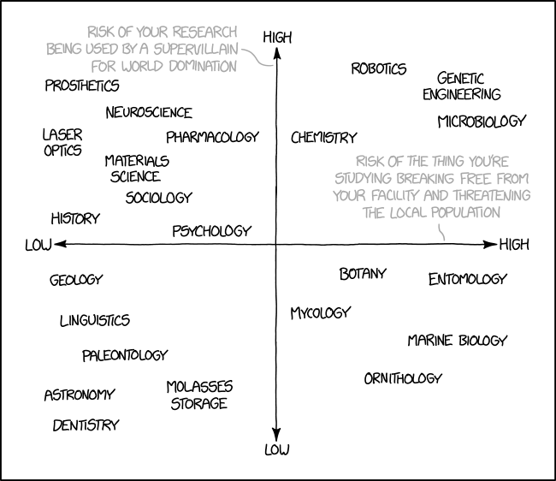
From this point on…you’re a scientific researcher!
Congratulations
Mad or otherwise

Slide 20

Reflection & Writing – 10 Mins
Spend 10 mins just writing, you can either reflect on today’s lesson, capture ideas for a dissertation, reflect on today’s topics and how can they be applied to your research
Free write if you like also – just simply write.

Slide 21

Questions??
Or answers ?

